Slide 1
Lake Kilroy Water Quality Manual
Vir Patel 2024

Slide 2
Table of Contents
Project Overview
Parts Used
Assembly
Data Collection
Placement in Water
Maintenance
FAQS
Teachers Guide

Slide 3
Project Overview
A buoy in Lake Kilroy and two stationary water quality detection devices in the inlet and outlet that measure
Temperature
Conductivity
pH
Dissolved oxygen
Sends data to a cloud based server (Thingspeak). Publicly accessible - anyone will be able to see the data

Slide 4
Parts Used (Hardware)
Important-
Atlas Scientific Hydroponics Kit (Kit onboard each system that measures the quality)
Rest of Parts
https://docs.google.com/spreadsheets/d/1iGlsB16ozPbOHlYz1lwc87Y9g158pxgvj_GzSOxiuuU/edit?usp=sharing

Slide 5
Parts Used (Software)
Arduino IDE (Used version 2.3.2)
https://www.arduino.cc/en/software
Code Used
https://github.com/Atlas-Scientific/Ezo_I2c_lib/blob/master/Examples/IOT_kits/hydroponics_kit/hydroponics_kit.ino

Slide 6
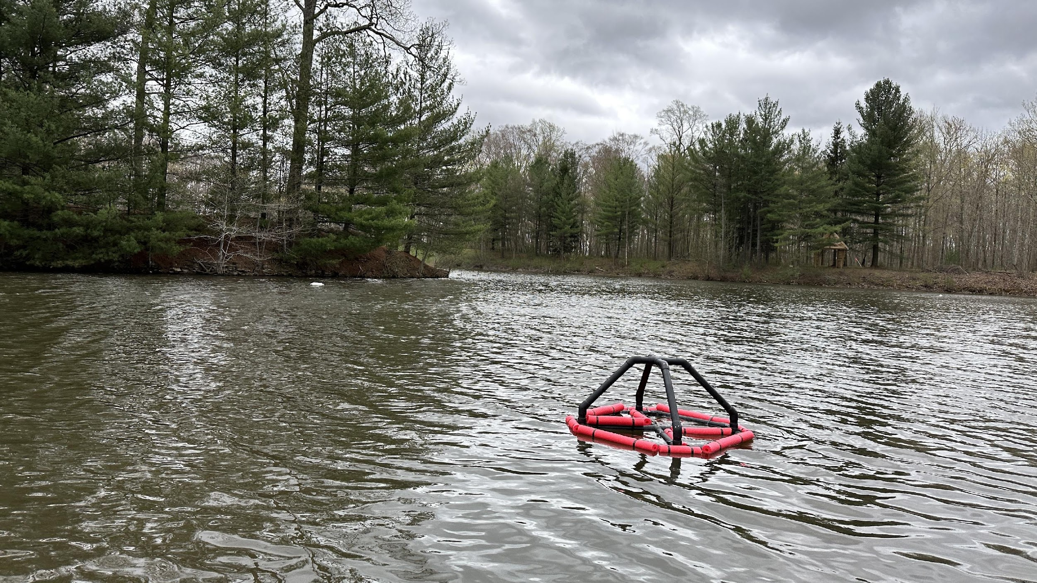
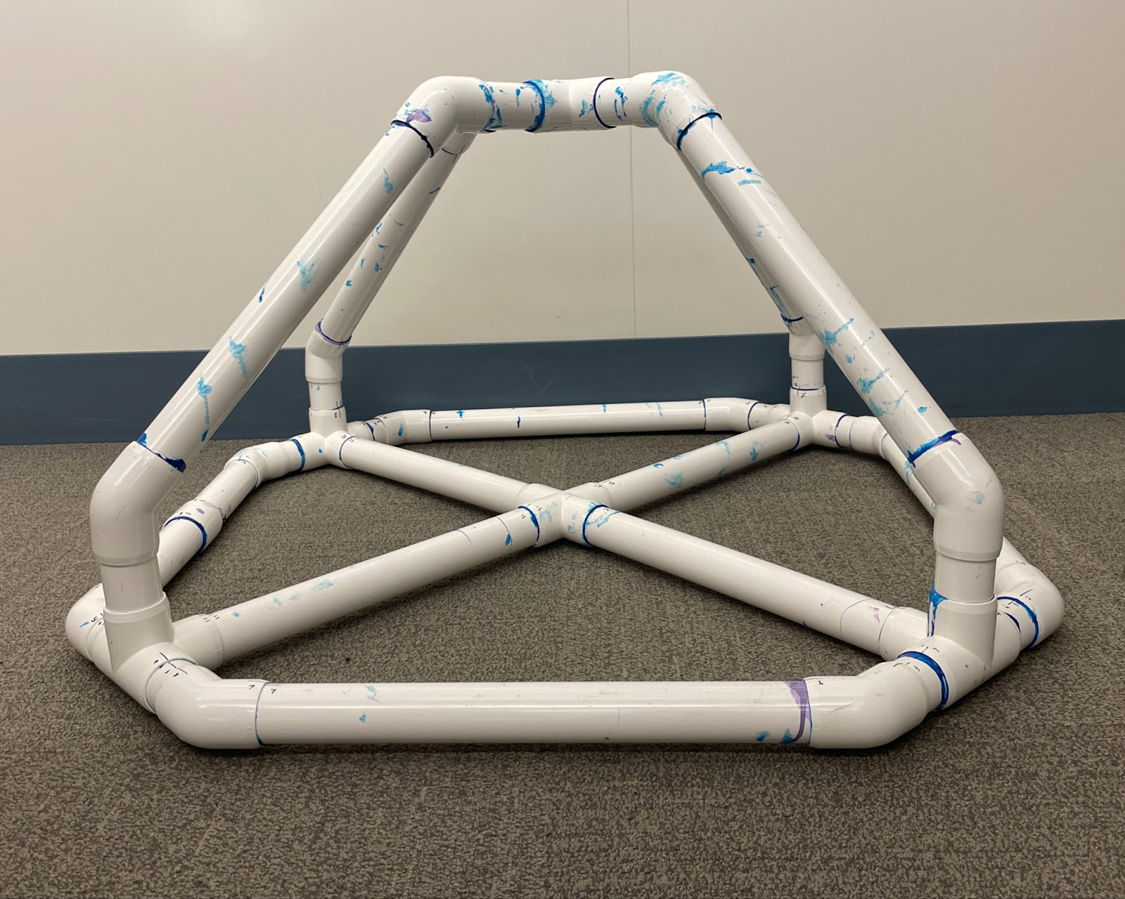
Assembly (Buoy)
The Buoy is assembled with High Grade Marine PVC pipe
The joints are glued together with PVC two part glue, marine caulk, and flex seal

Slide 7
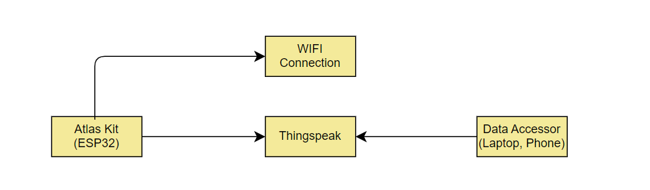
Data Collection Setup
The Atlas Scientific Kit connects to the internet and sends it to thingspeak by finding its channel id and api key.
The Buoy will only upload if connected to a stable wifi connection

Slide 8
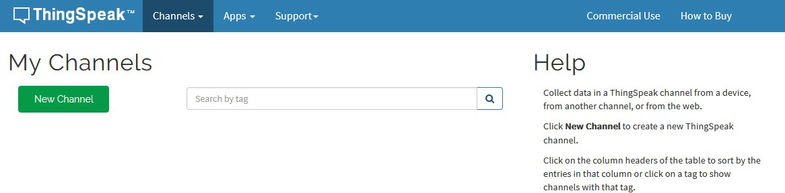
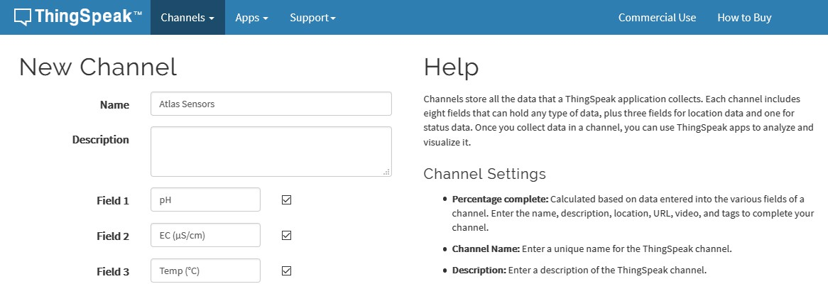
Data Collection (Thingspeak) Setting Up New Channel
Your data is uploaded to ThingSpeak through a ‘Channel.’ Select New Channel
Fill out the highlighted boxes. (Be sure to click on the checkboxes to enable field 2 and 3) For reference, this is what we entered.
Name
Atlas Sensors
Field 1 pH
Field 2 EC (μS/cm)
Field 3 Temp (°C)
Scroll to the bottom of the page and click Save Channel.

Slide 9
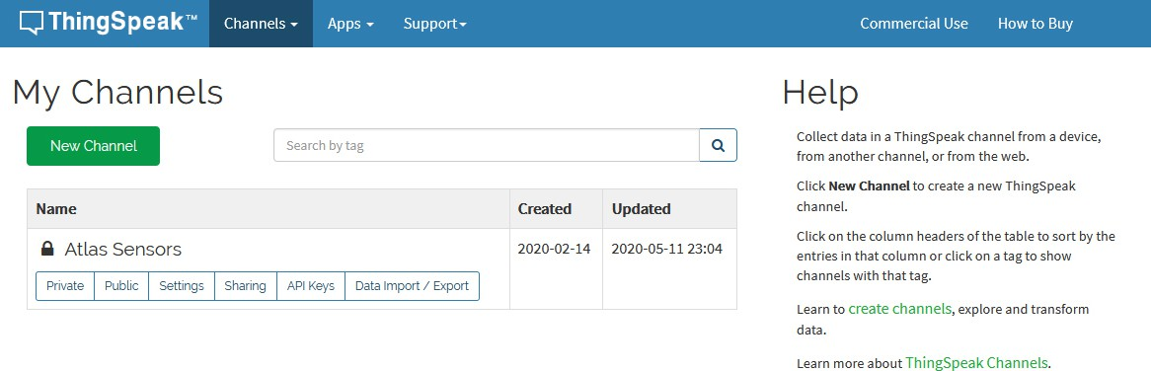
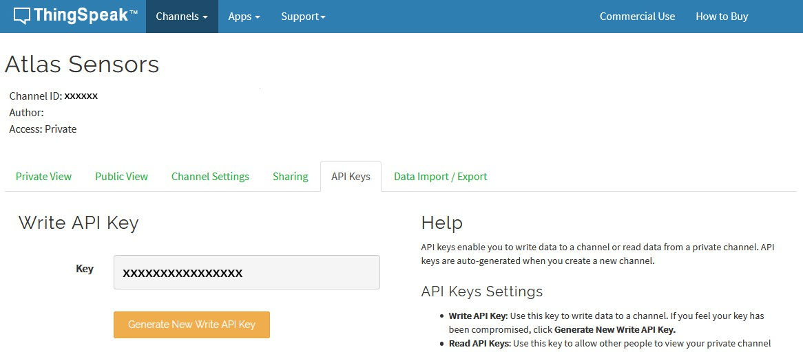
After you saved your channel settings, you will be redirected to your channel page. Click on API keys.
Be sure to save your Channel ID and Write API Key we are going to need these, in the next few steps.

Slide 10
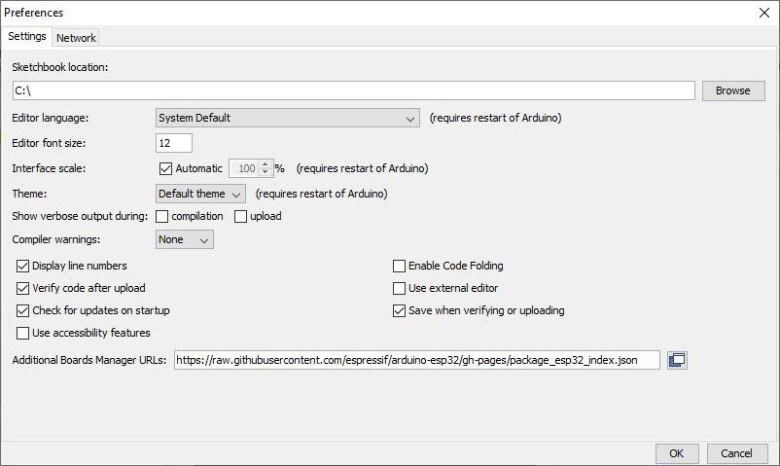
Data Collection (Arduino Setup)
Download Arduino- Used the Latest version (However I used 2.3.2) Refer to Slide 5 for link
Make sure your Arduino IDE libraries are up to date
Make sure you have the correct path for the Esp32 Library
In the IDE, go to File > Preferences
Locate the Additional Boards Manager URLS text box.
Make sure this URL is in the textbox
https://raw.githubusercontent.com/espressif/arduino-esp32/gh-pages/package_esp32_index.json Click OK.

Slide 11
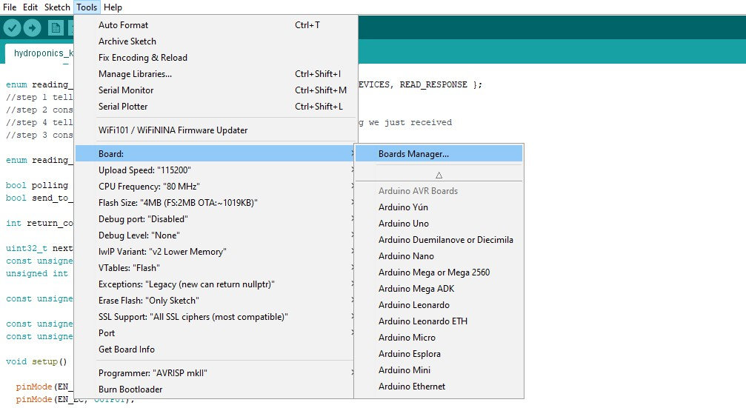

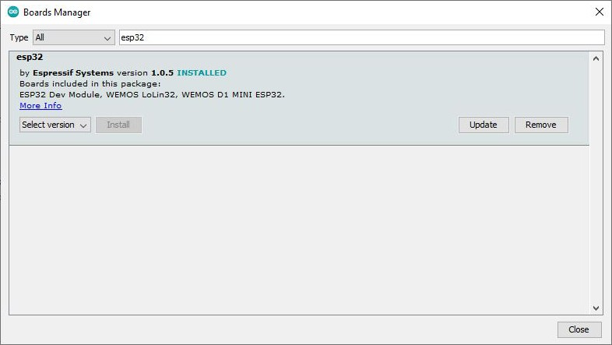
Update the esp32 board
In the IDE, go to Tools > Board > Boards Manager
In the search bar of the Boards Manager, lookup esp32.
Update to the most recent version if you don’t already have it.
(Version 1.0.5 in not the most recent version)

Slide 12
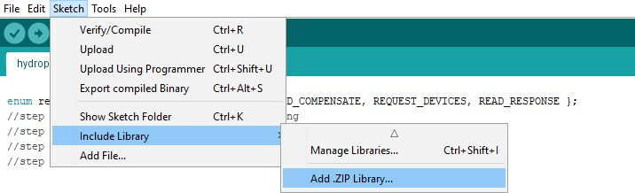
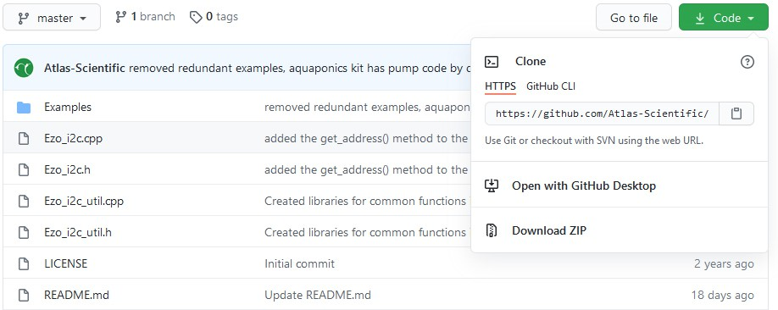
Download the ThingSpeak library for Arduino
Click HERE to download the latest version of the ThingSpeak library.
Don’t unzip it!
Import the .ZIP file into your Arduino IDE.
To import the .ZIP file go to Sketch > Include Library > Add .ZIP Library
Add the EZO I2C Library
To download the Ezo_I2c library file, click HERE.
Don’t unzip it!
Import the .ZIP file into your Arduino IDE.
To import the .ZIP file go to Sketch > Include Library > Add .ZIP Library

Slide 13
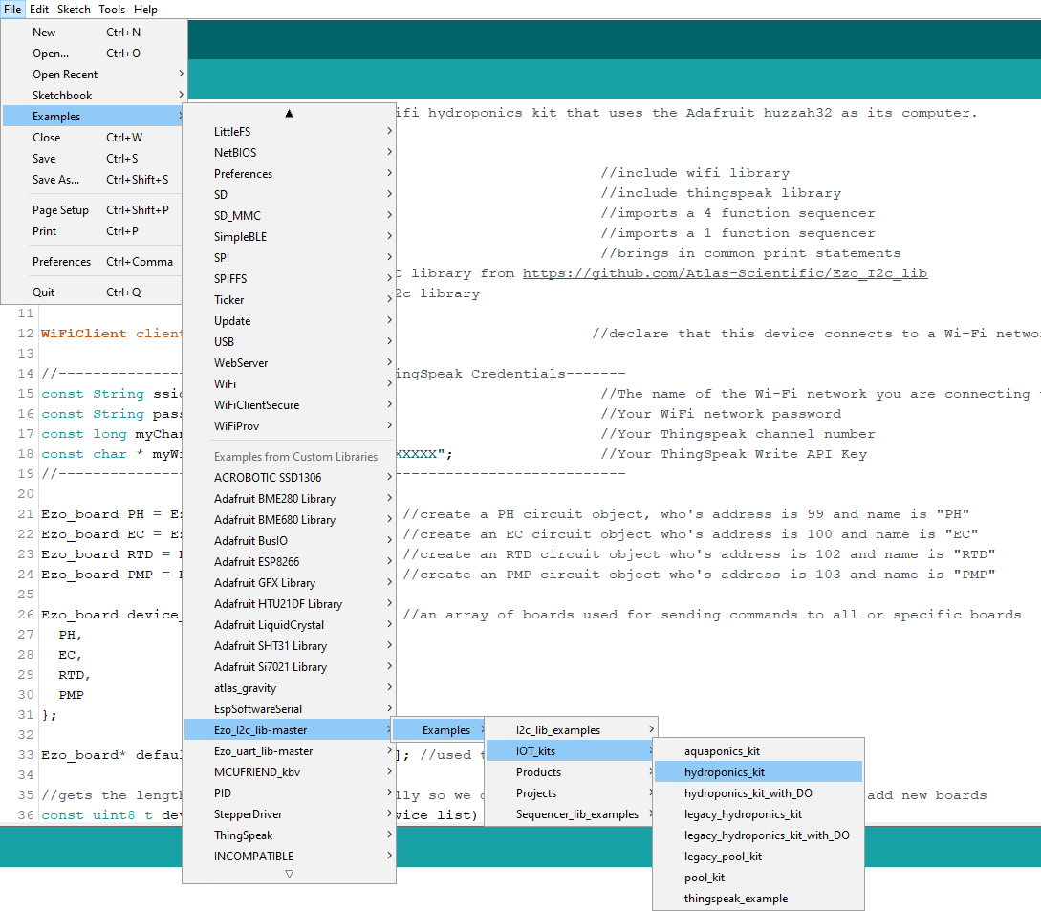
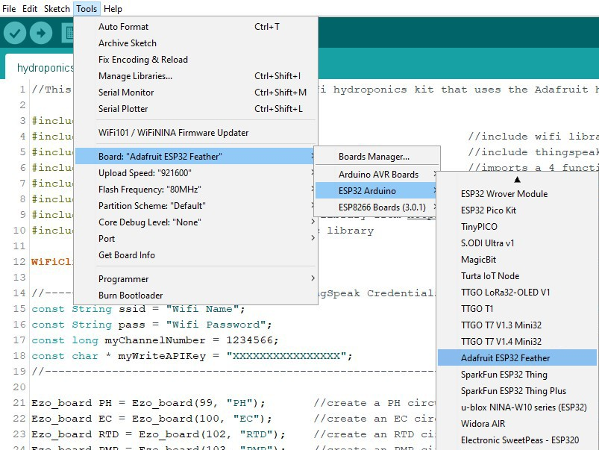
Flash the Hydroponics meter with the correct code
Select, open and adjust the code you want to use for your Wi-Fi Kit
File> Examples> EZO_I2C_lib-master> Examples> IOT_kits> hydroponics_kit
Setting up the HUZZAH board
Set the target CPU to flash
Tools> Board> ESP32 Arduino > Adafruit ESP32 Feather
Enlarge Photos if Needed

Slide 14
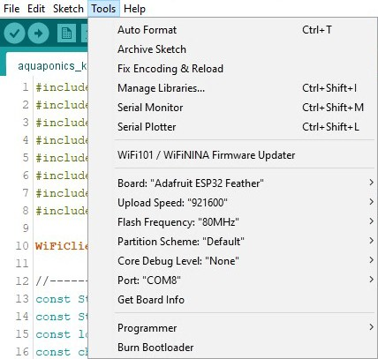

Adjust CPU Settings
Make sure the CPU settings on the Adafruit HUZZAH32 are correct. To adjust the CPU settings, click Tools.
For reference, this is what Atlas Scientific set the CPU settings to.
(your options may not be exactly the same, just try and match them as closely as possible. Don't forget to set the correct com port for your device.)
Compile and upload
Compile and upload the code.

Slide 15
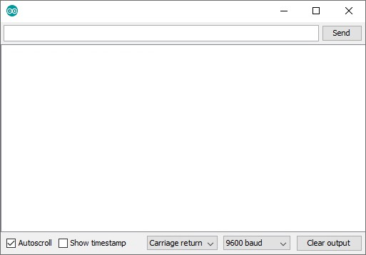
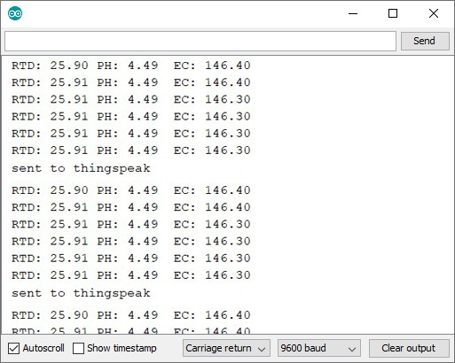
See the readings
Open your Arduino serial monitor.
(You must have the serial monitor set to the com port from the Adafruit HUZZAH32.)
Set to carriage return and 9600 baud.
The Wi-Fi Hydroponics Meter will always attempt to connect to ThingSpeak on bootup.

Slide 16
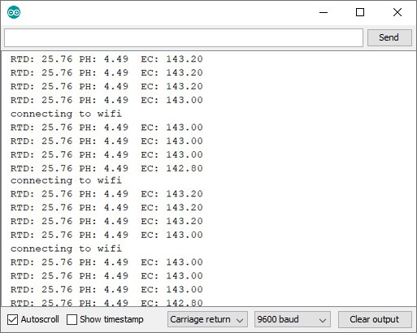
If it cannot connect to your Wi-Fi you will see this:
Entering the poll command will stop the Wi-Fi Hydroponics Meter from uploading the readings to thingspeak, while you debug your Wifi problems.

Slide 17
Data Collection (WIFI Connection)
The Buoy Atlas Scientific kit connects to a CC vector WIFI repeater.
Manual for Repeater
https://ccrane.com/content/manuals/CC-Vector-Quick-Start-Setup-Guide-V4-2020-Rev5A.pdf

Slide 18
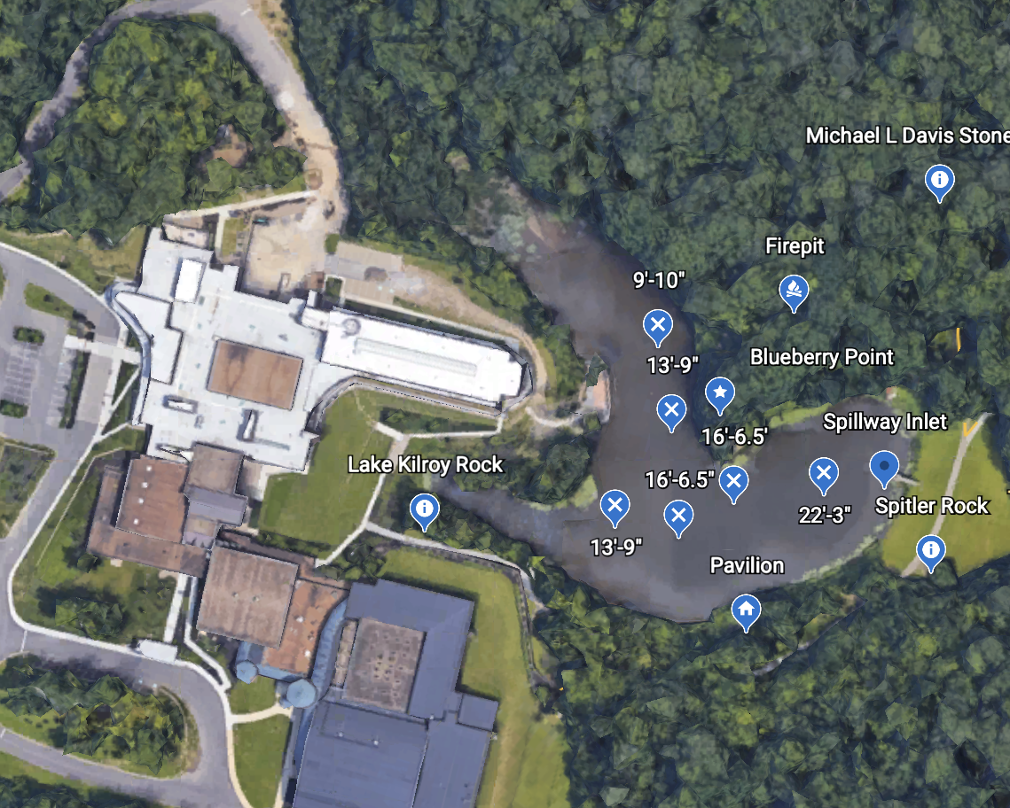
Placement in Water
The Buoy is place in the deepest part of the lake, so the two level system can be effective (White Arrow)
The inlet is where one of the stationary systems go (Orange Arrow) Mckeown will show you
Outlet is in the fish hatchery

Slide 19
Maintenance
The Buoy will require Maintenance
Some possible Maintenance issues
Calibration
Next Slide
Fouling Probes
Guide I have used Here
Batteries running out of charge
Take it off the unit and charge. Make sure to reposition the solar panel so that it gets sunlight

Slide 20
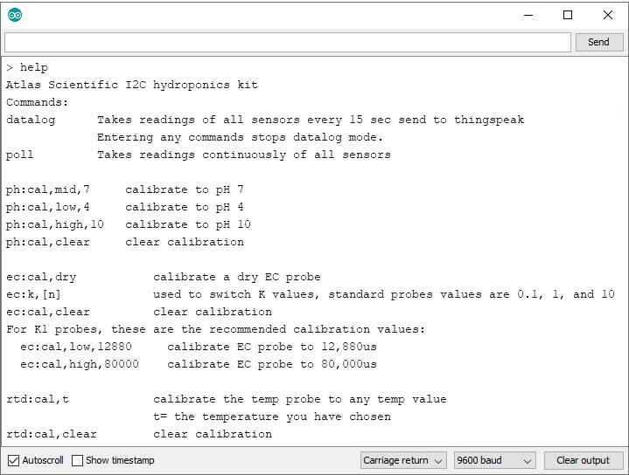
Sensor Calibration
Atlas Scientific created a list of calibration commands that are built into the library. Type in help to see a list of commands.
The poll command
Send the command poll; This will let you see the readings once per second and it will stop uploading to ThingSpeak while you calibrate.

Slide 21






B
Calibrate pH
When calibrating pH, you must always calibrate to pH 7 first.
Remove the soaker bottle and rinse off the pH probe. Remove the top of the pH
7.00 calibration solution pouch. Place the pH probe inside the pouch and let the probe sit in the calibration solution until the readings stabilize. This will take about 1 – 2 mins.
After Calibration
1 − 2 mins
ASPH7P
6.917
7.126
7.223
Unstabilized
Once the readings have stabilized, issue the Mid point calibration
7.225
7.225
7.225
7.225
command. ph:cal,mid,7
Stabilized
ph:cal,mid,7
After 20 mins, the calibration solution inside an open pouch is no longer considered accurate.
Send

Slide 22
Rinse off the probe and repeat this process for both pH 4.00 and pH 10.00.
^{C} Calibrate Conductivity
Setting the Conductivity probe type
If your probe ≠ K 1.0 (default), then set the probe type by using the ec:k,n command. (where n = K value of your probe)
Example, if you have a K 0.1 conductivity probe issue the command ec:k,0.1
When calibrating Conductivity, you must always calibrate a dry probe first.
Make sure that the probe is dry before issuing this command, ec:cal,dry

Slide 23
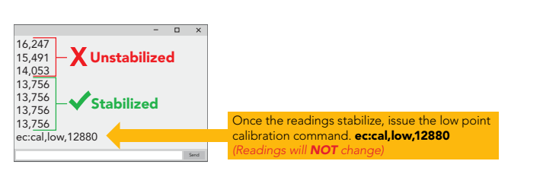
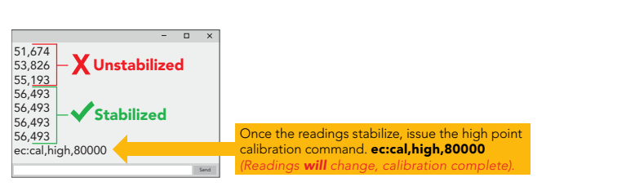
Once the dry calibration has been completed, place the probe into a small cup of the low point calibration solution. Shake the probe to make sure you do not have trapped air bubbles in the sensing area. You should see readings that are off by 1 – 40% from the stated value of the calibration solution. Wait for readings to stabilize.
12,880μS
12,880μS
7,728µS – 18,032µS
0.00µS
Trapped air in sensing area (shake to remove)
check probe connection, you cannot calibrate to 0.
Rinse off the probe before calibrating to the high point. Pour a small amount of the high point calibration solution into a cup. Shake the probe to remove trapped air. Again, the readings may be off by 1 – 40% Wait for readings to stabilize.

Slide 24

^{D} Calibrate Temperature
Calibrating the PT-1000 temperature probe is not required. However, if you want to, a simple method to calibrate the probe is to place the PT-1000 into boiling water. Then issue command rtd:cal,t
100 °C
Elevation in meters
305
229
152
76
0
-76
-152
Boiling point
98.9 °C
99.2 °C
99.5 °C
99.7 °C
100 °C
100.3 °C
100.5 °C
Calibration Complete

Slide 25
FAQS
The Atlas is running but the wifi is not. What do I do?
Check ur code. Make sure you have the right ssd and password. Power Cycle the router.
What happens if the Buoy has a leak and takes in water?
First find the leak. There are many options to stop it. Putty, more flex seal or waterproof tape. The long term option is to strip the area of sealant with acetone, then caulk and seal the spot again.

Slide 26
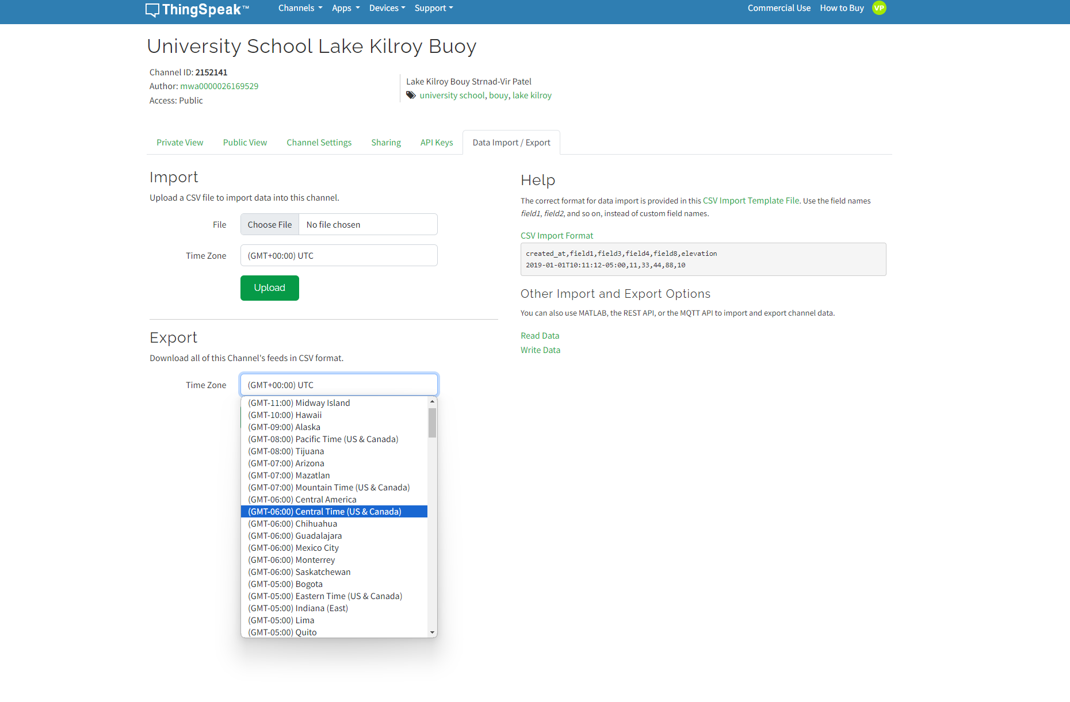
Teachers Guide
I want to Export the data for my class.
Go to the thingspeak link here (You need an account)
Go to the Data import/Export tab of the thingspeak channel
Set your time to GMT-4
Export to an .csv file to either google sheets or Excel

Slide 27
Future Enhancements

